Slide 1
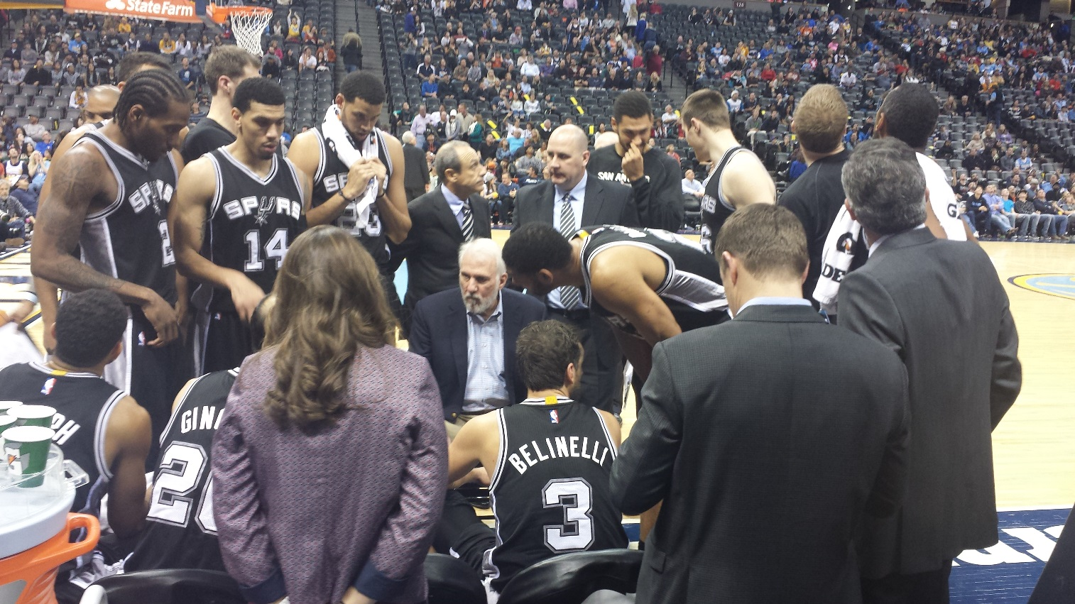
Photo courtesy of: Sohaib Ahmed
Predicting NBA Team Success and Player Performance Through Data Analytics
December 2016
Sohaib Ahmed
Data Science Essentials CSC570 | Mike Bernico

Slide 2
Outline
1. Purpose
2. Background information
3. Key Feature Information
4. Team Success Predictor (Random Forest Model)
5. Player Performance Identifier (K-Means Clustering Model)
6. Player Comparison Tool (Recommender System Model)
7. Overall Analysis
8. Works Cited

Slide 3
Purpose
Objective
The purpose of this project is to predict an NBA player’s performance and team’s success through the use of various data models, specifically predicting a team’s chances for making the playoffs for the 2016-2017 season. as a means to aid franchises, fans, and other third party users to enhance their understanding of the game of basketball.
Approach
Use case and requirement analysis
Understand role of stats, data, and analytics in professional men’s basketball
Identify key features
Identify key criteria for model creation
Identify models
Identify leading enterprise search vendors based on Accenture’s prior experience
Identify vendors based on GASCO IT’s preference /recommendation
Overall analysis
Reflect on process and overall quality of models and accuracy
Key Deliverables/Outcomes
Data analytics models to predict a team’s success and a player’s performance
Frameworks and Tools
Random Forest Model for Team Success Prediction, K-Means Clustering for player performance, and Recommender System Model for Player Comparison
Mike Bernico lectures and YouTube tutorials accessed via UIS Blackboard
Python Code
iPython Notebook, GitHub, OpenOffice
Notes:
1. This talks about the overall approach and also the resources which used to create this report

Slide 4
Outline
Table of contents
1. Purpose
2. Background information
3. Key Feature Information
4. Team Success Predictor (Random Forest Model)
5. Player Performance Identifier (K-Means Clustering Model)
6. Player Comparison Tool (Recommender System Model)
7. Overall Analysis
8. Works Cited

Slide 5
Required and Desirable Features
Feature Requirements
Following key requirements were identified for a successful implementation of the NBA team success and player performance models
Required Features
Provide basic predictor model for team success with Random Forest
Player performance indicator through K-Means clustering
Player comparison aid for “money ball” statistics and fantasy basketball league
Desirable/Nice to have
Provide each team’s probability of making playoffs in 2016-2017 season
Provide head to head player comparisons
Notes:
This is the assimilated feature list after mapping all the use cases captured to a specific search feature requirement. Some are required, i.e, key to GASCO employee success, and some are desirable based on the North Star view provided to the user representative during the “Art of Possible” discussion.

Slide 6
Resources for Model Selection
Mike Bernico lecture materials and YouTube tutorials accessed via University of Illinois at Springfield Blackboard
Ipython 2.7
http://www.basketball-reference.com/
http://www.nba.com/

Slide 7
Outline
Table of contents
1. Purpose
2. Background information
3. Key Feature Information
4. Team Success Predictor (Random Forest Model)
5. Player Performance Identifier (K-Means Clustering Model)
6. Player Comparison Tool (Recommender System Model)
7. Overall Analysis
8. Works Cited

Slide 8
Key Feature Information
Overview
When selecting features, or statistics, that are appropriate to calculate and predict an NBA franchise’s success, especially when trying to predict of the team will make the playoffs, a data scientist would normally want to include all the basic game by game and per game statistics readily available to the public. However, in order to make any algorithm more accurate, precise, and robust, one would need access to the advanced statistics the league produces, unfortunately, those advanced statistics such as player efficiencies, team and player quarterly statistics, and advanced data such as player tendencies and advanced metrics, are not readily available to the public directly by the NBA, in fact, most, if not all data comes from reputable third party providers.
Key Features
Challenges
NBA does not provide actual access to their statistics and data
Appropriate advanced statistics and data were not readily available via third party providers
Basic team per game statistics for 2015-2016 and 2016-2017 NBA seasons (See next slides)
Basic active player per game statistics for current 2016-2017 NBA season (See next slides)

Slide 9
Key Feature Information
Team Per Game Statistics
The following statistics were use for Team statistics, provided by http://www.basketball-reference.com/.
Key Features (Per Game)
Rk – Rank (Current)
Team – Franchise Name
G – Games played
MP – Minutes Played
FG – Field Goals
FGA – Field Goals Attempted
FG% - Field Goal Percentage
3P – 3 Pointers Made
3PA – 3 Pointers Attempted
3P% - 3 Pointer Percentage
2P – 2 Pointers Made
2PA – 2 Pointers Attempted
2P% - 2 Pointer Percentage
FT – Free Throws
FTA – Free Throws Attempted
FT% - Free Throws Percentage
ORB – Offensive Rebounds
DRB – Defensive Rebounds
TRB – Total Rebounds
AST - Assists
STL - Steals
BLK - Blocks
TOV - Turnovers
PF – Personal Fouls
PTS – Total Points

Slide 10
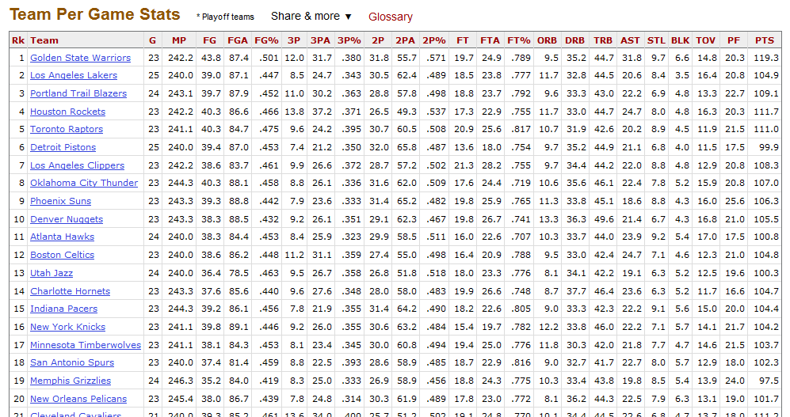
Key Feature Information
Team Per Game Statistics
The following screenshot was taken for example, provided by http://www.basketball-reference.com/.

Slide 11
Key Feature Information
Player Per Game Statistics (2016-2017)
The following statistics were use for Team statistics, provided by http://www.basketball-reference.com/.
Key Features (Per Game)
Pos – Position
Age – Player Age
Tm – Franchise Name
G – Games played
GS – Games Started
MP – Minutes Played
FG – Field Goals
FGA – Field Goals Attempted
FG% - Field Goal Percentage
3P – 3 Pointers Made
3PA – 3 Pointers Attempted
3P% - 3 Pointer Percentage
2P – 2 Pointers Made
2PA – 2 Pointers Attempted
2P% - 2 Pointer Percentage
FT – Free Throws
FTA – Free Throws Attempted
FT% - Free Throws Percentage
ORB – Offensive Rebounds
DRB – Defensive Rebounds
TRB – Total Rebounds
AST - Assists
STL - Steals
BLK - Blocks
TOV - Turnovers
PF – Personal Fouls
PTS – Total Points
eFG% - Effective Field Goal Percentage

Slide 12
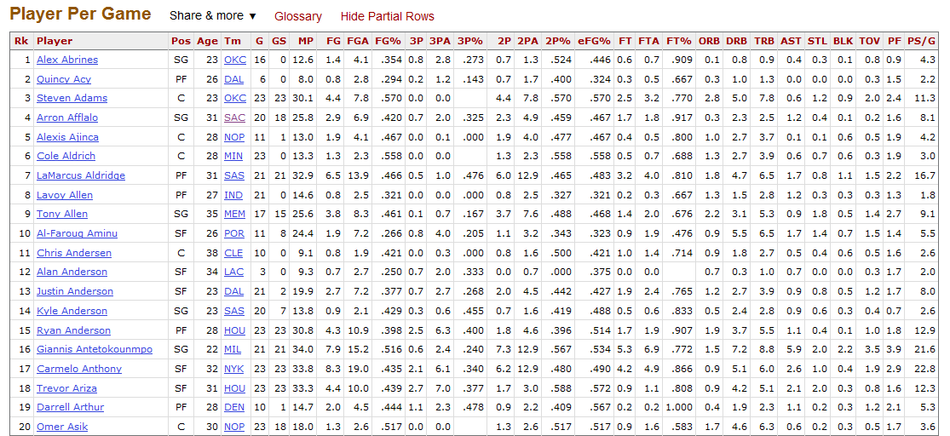
Key Feature Information
Player Per Game Statistics
The following screenshot was taken for example, provided by http://www.basketball-reference.com/.

Slide 13
Outline
Table of contents
1. Purpose
2. Background information
3. Key Feature Information
4. Team Success Predictor (Random Forest Model)
5. Player Performance Identifier (K-Means Clustering Model)
6. Player Comparison Tool (Recommender System Model)
7. Overall Analysis
8. Works Cited

Slide 14
Team Success Predictor (Random Forest Models)
Overview
By definition,”…in random forest models, each tree in the ensemble is built from a sample drawn with replacement from the training set…As a result of this randomness, the bias of the forest usually slightly increases (with respect to the bias of a single non-random tree) but, due to averaging, its variance also decreases” (scikit-learn). Random Forests are a very popular model when predicting outcomes in sports and provide a good measuring stick of what to predict as the real outcome. By using this model, we are able to compare each team’s statistics and have them go to head to predict who would have greater success. In this case, the model ended up with a an AUC score of 0.666666666667. As a seasoned fanatic of the game, although the score may seem low, I believe this to be optimistic.
Key Features
Challenges
Appropriate advanced statistics and data were not readily available via third party providers
Due to many external factors such as injuries and scheduling, accuracy of model can be compromised
Model allows teams to go head to head based on provided statistics
Model can predict if a team will make the playoffs
Model trained on 2015-2016 NBA season to provide the most relevant stats due to trades, injuries, etc..
Model can predict team’s probability of making the playoffs

Slide 15
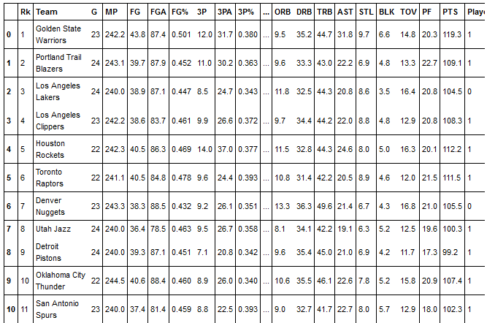
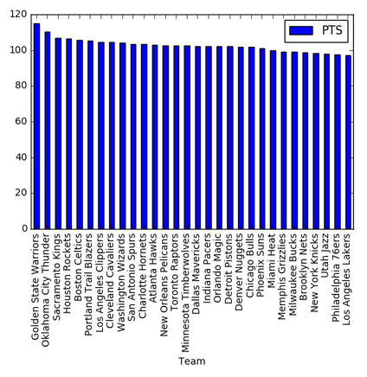
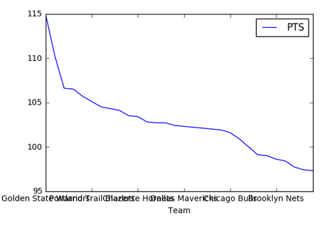
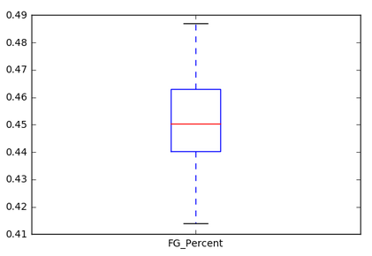
Team Success Predictor (Random Forest Models)
Exploratory Data Analysis and Visualization of Data
Before implementing this model, I performed a simple EDA and visualization to better understand the information I was working with. By doing so, I was able to get a better feature selection and knowledge of how my model would work. Examples shown below:

Slide 16
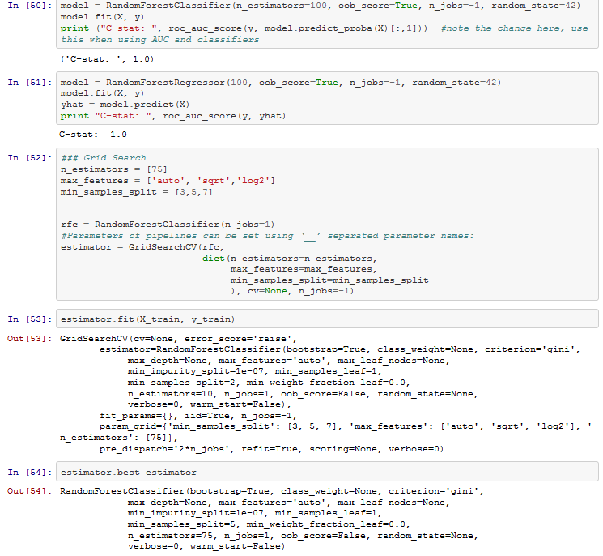
Team Success Predictor (Random Forest Models)
Model Structure (Code Snippet)

Slide 17
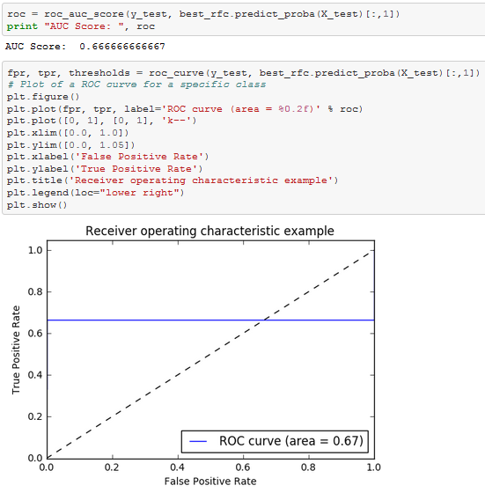
Team Success Predictor (Random Forest Models)
Visual Representation of Model and Model Outcome
Below is a visual of the AUC score, as well as a chart depicting the influence of each feature when predicting the outcome.

Slide 18
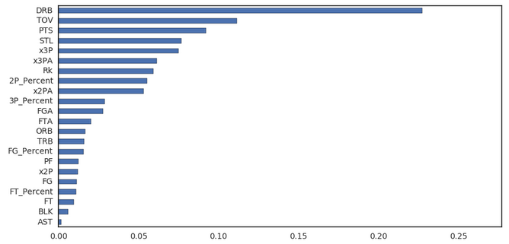
Team Success Predictor (Random Forest Models)
Visual Representation of Model and Model Outcome
Below is a visual of a chart depicting the influence of each feature when predicting the outcome. As we can see, this just reaffirms the very important saying of how, “defense wins games”. The feature with the most influence is defensive rebounds, followed by committing turnovers. So if a team was deficient in these categories, they would likely want to focus on addressing those weaknesses by practice, or by player acquisition.

Slide 19
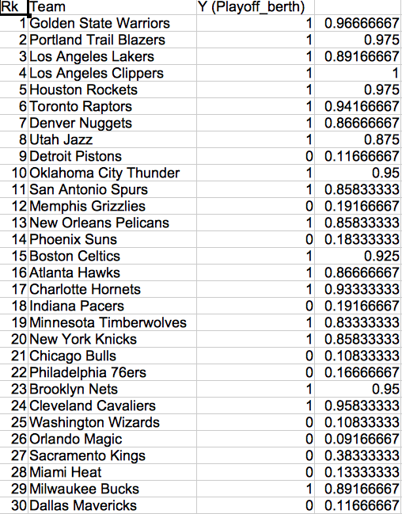
Team Success Predictor (Random Forest Models)
Model Outcome
Based on my Random Forest Model, here is each team’s probability of making the playoffs:

Slide 20
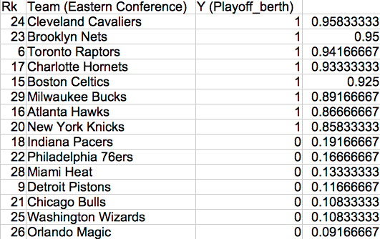
Team Success Predictor (Random Forest Models)
Model Outcome
Here is a view based on the eastern conference. As we can see, the model does provide a decent prediction based on this season’s stats. However, since the season just began in late October, this won’t provide enough information to those new to the sport. For example, the Brooklyn Nets have a 95% of making the playoffs when in reality, their performance has been subpar at best, whereas teams such as the Chicago Bulls would have a much higher chance of making the playoffs (11% probability).

Slide 21
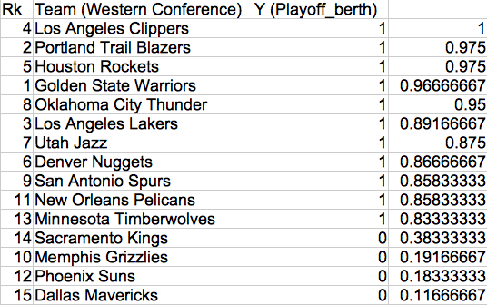
Team Success Predictor (Random Forest Models)
Model Outcome
Here is a view based on the western conference. As we can see, the model does provide a decent prediction based on this season’s stats. However, since the season just began in late October, this won’t provide enough information to those new to the sport. For example, the San Antonio Spurs do have a playoff berth in my model, but just miss the playoffs because the first eight teams have a higher chance. However, in reality, we know that the Spurs are one of the top contenders in league.

Slide 22
Outline
Table of contents
1. Purpose
2. Background information
3. Key Feature Information
4. Team Success Predictor (Random Forest Model)
5. Player Performance Identifier (K-Means Clustering Model)
6. Player Comparison Tool (Recommender System Model)
7. Overall Analysis
8. Works Cited

Slide 23
Player Performance Identifier (K-Means Clustering Model)
Overview
By definition, “The K-Means algorithm clusters data by trying to separate samples in n groups of equal variance, minimizing a criterion known as the inertia or within-cluster sum-of-squares. This algorithm requires the number of clusters to be specified. It scales well to large number of samples and has been used across a large range of application areas in many different fields” (scikit-learn). By understanding the previous model, we can apply that knowledge to make teams, and fantasy teams better, by addressing key areas of deficiency. Teams can use this model to understand which players are important infuencers to the game, key role players, and reserve type players based on how they are clustered. All basic player stats information is used.
Key Features
Challenges
Appropriate advanced statistics and data were not readily available via third party providers
Due to many external factors such as injuries and scheduling, accuracy of model can be compromised
Model allows players to go head to head based on provided statistics
Model can predict if a player is a starter type, role player, bench, or reserve player based on clustering
Model trained on 2016-2017 NBA season to provide the most relevant stats due to trades, injuries, etc..

Slide 24
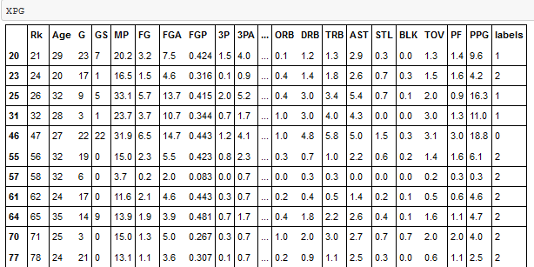
Player Performance Identifier (K-Means Clustering Model)
Overview
By dividing all players by position, the model can best decide which players are best at that position. Players clustered as 0 would be considered starter type players, 1 would be key role player types, and 2 would indicate bench/reserve type players.

Slide 25
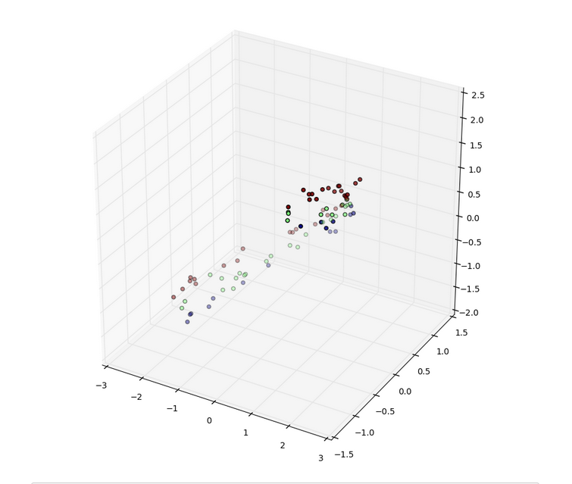
Player Performance Identifier (K-Means Clustering Model)
Overview
Below is an example visual representation of how the point guards are clustered in the model:

Slide 26
Outline
Table of contents
1. Purpose
2. Background information
3. Key Feature Information
4. Team Success Predictor (Random Forest Model)
5. Player Performance Identifier (K-Means Clustering Model)
6. Player Comparison Tool (Recommender System Model)
7. Overall Analysis
8. Works Cited

Slide 27
Player Comparison Tool (Recommender System Model)
Overview
Just like we see on Netflix or Amazon, systems may recommend movies, or products that may interest us based on our habits. Just as in basketball, we can see which players compare to each other based on their basic statistics. Teams can in turn, use this as a way to play “money ball” by acquiring players that resemble the performance of other players, but at a discounted contract rate. Please access the GitHub repository for this model to better understand how this was used. In the following slides, we see just how powerful the model can be.
Key Features
Challenges
Appropriate advanced statistics and data were not readily available via third party providers
Due to many external factors such as injuries and scheduling, accuracy of model can be compromised
Model allows players to go head to head based on provided statistics
Model can predict if a player is similar to another player based on statistics
Model trained on 2016-2017 NBA season to provide the most relevant stats due to trades, injuries, etc..

Slide 28
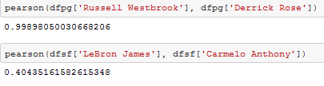
Player Comparison Tool (Recommender System Model)
Overview
Based on our model, we can compare player similarities by putting them head to head. Below we can see the playing style of Russell Westbrook, aspiring MVP, and Derrick Rose, 2011 NBA MVP, are 99% similar, whereas LeBron James and Carmelo Anthony are only 40% similar. With that being said, it is important to follow the NBA to actually understand the intricate dynamics between each player and position, and must make decisions accordingly.

Slide 29
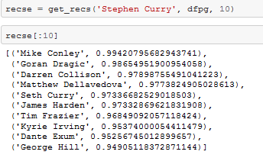
Player Comparison Tool (Recommender System Model)
Overview
Below we can see the top ten players most similar to Stephen Curry. This information is helpful when trying to play “money ball” becauseteams can use this to their advantage to acquire players that can perhaps best defend against the reigning MVP.

Slide 30
Outline
Table of contents
1. Purpose
2. Background information
3. Key Feature Information
4. Team Success Predictor (Random Forest Model)
5. Player Performance Identifier (K-Means Clustering Model)
6. Player Comparison Tool (Recommender System Model)
7. Overall Analysis
8. Works Cited

Slide 31
Overall Analysis
Conclusion
As teams, players, and fans use data and data analytics to better enhance the sport, I believe there needs to be an understanding of balancing the data with reality. Although the random forest model has an AUC score of 0.67, this may seem low, but would actually be high, in my opinion. I say this because there are so many external factors and features that are unaccounted for. I believe we can best use these models to help aid in the enhancement of the sport, and not just fully rely on it.

Slide 32
Outline
Table of contents
1. Purpose
2. Background information
3. Key Feature Information
4. Team Success Predictor (Random Forest Model)
5. Player Performance Identifier (K-Means Clustering Model)
6. Player Comparison Tool (Recommender System Model)
7. Overall Analysis
8. Works Cited

Slide 33
Works Cited
http://scikit-learn.org/stable/

